Slide 1
Traffic Racer Computer graphics project
SUPERVISOR:
ENG. YAHIA ETMAN

Slide 2
WORK LOAD
KARIM SAQER. SEC:2 B:9
KARIM MOHAMED. SEC:2 B:8
PHASE 1:
MESH
TRANSFORM
FORWARD RENDERER SYSTEM
SKY RENDERING
POSTPROCESSING
PHASE 2:
LIGHTING
COLLISION SYSTEM
MAIN MENU & GAME-OVER MENU

Slide 3


Slide 4
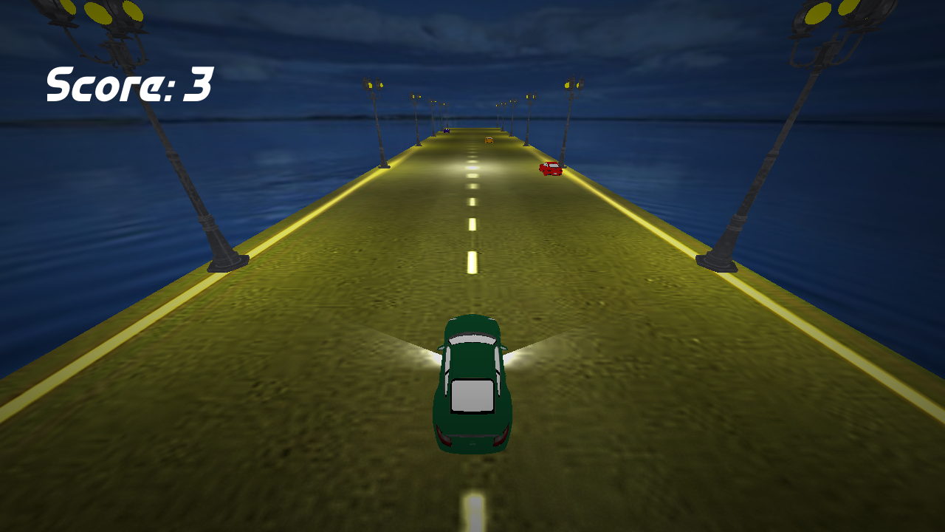

Slide 5


